Slide 1
ME5413 Final Project Presentation Group 12
ZXXXX AAAAAAAAA
Sun Cheng A0303599U
ZXXXX AAAAAAAAA
ZXXXX AAAAAAAAA
ZXXXX AAAAAAAAA
ZXXXX AAAAAAAAA

Slide 2
Panelists and contributions
Name | Student ID | Contributions
SUN Cheng | A0303599U | Box identification and counting & Write report & PPT

Slide 3
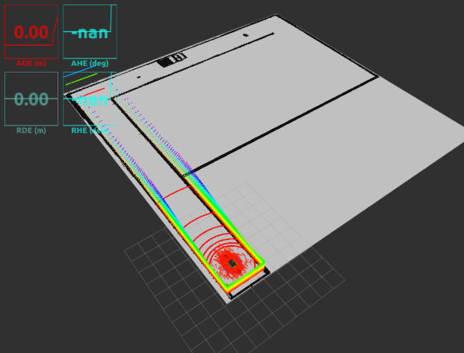
Environment & Task Definition
Gazebo Simulation Environment
Sensors:
3D LiDAR (for SLAM & obstacle avoidance)
Front camera (for OCR digit recognition)
IMU
Autonomous Task Break down
Mapping: 2D grid map from 3D LiDAR via SLAM
Box OCR: Digit recognition with Tesseract
Bridge: Detect and cross random bridges
Unlock: Send unlock command within 10s
Docking: Target box with rarest digit
Gazebo Simulation

Slide 4
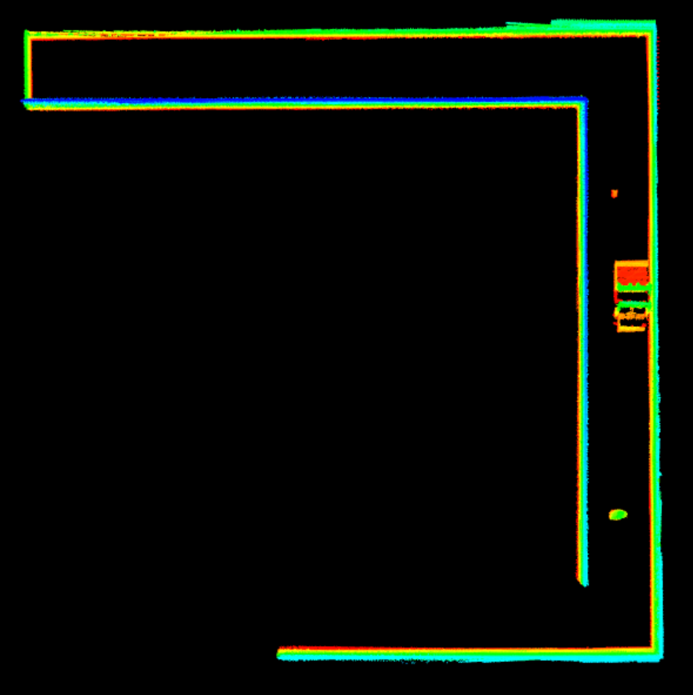
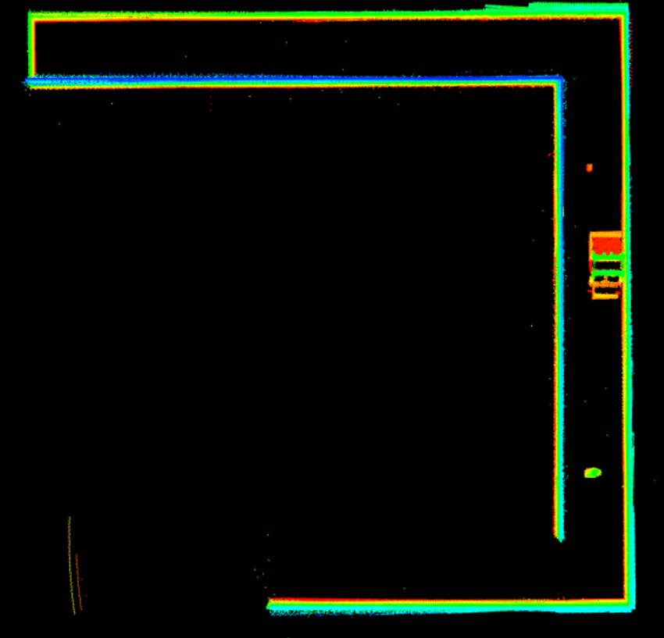
Mapping and SLAM
SLAM Algorithm: Fast-LIO
Type:Tightly-coupled LiDAR-Inertial SLAM
Data Source: 3D LiDAR point clouds + IMU
Why Fast-LIO:
High accuracy
Real-time performance
Better noise handling than Gmapping
Map Generation Pipeline
3D Point Cloud → 2D Projection
Custom ROS node pcd_to_map
Converts .pcd → occupancy grid (.pgm + .yaml)
Preprocessing Filters:
Pass-through filter: Remove ground/distant noise
Radius outlier removal: Eliminate sparse noise
(a) Pass-through Filter
(b) Radius Outlier Removal

Slide 5
SLAM Performance

Slide 6
Autonomous Navigation

Slide 7
Frontier Exploration & FSM

Slide 8
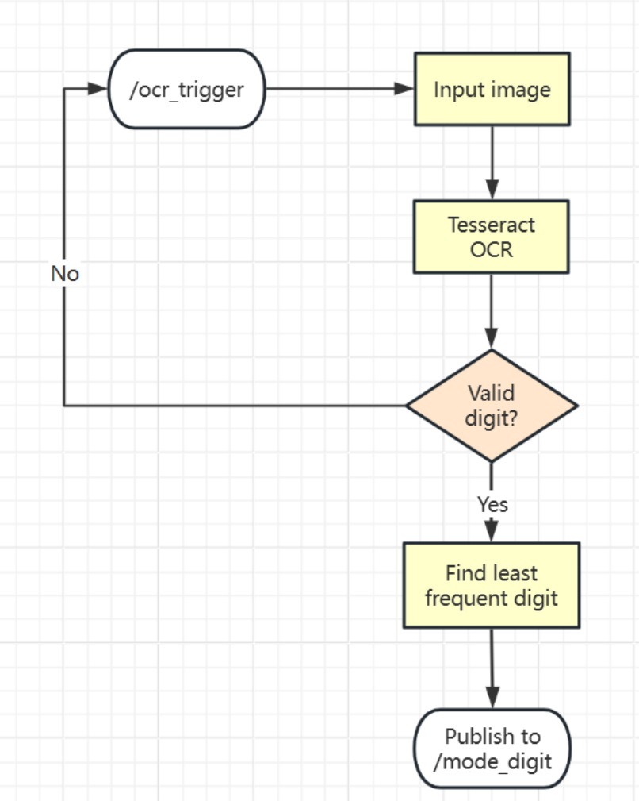
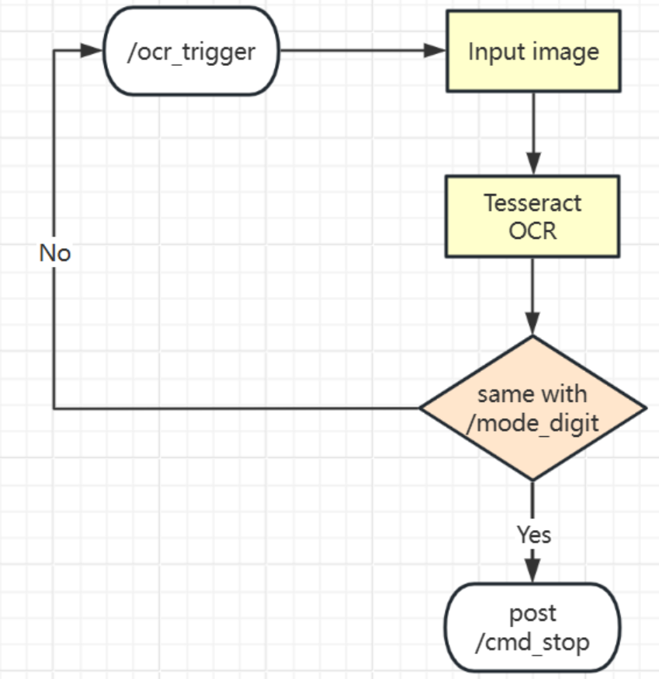
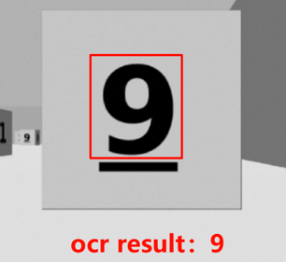
Box Identification via OCR
(a) Before bridge
(b) After bridge
(c) Test result

Slide 9
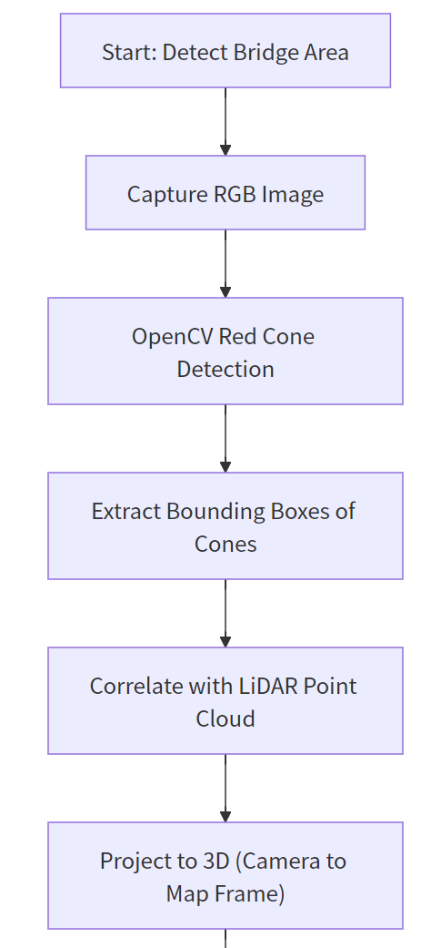
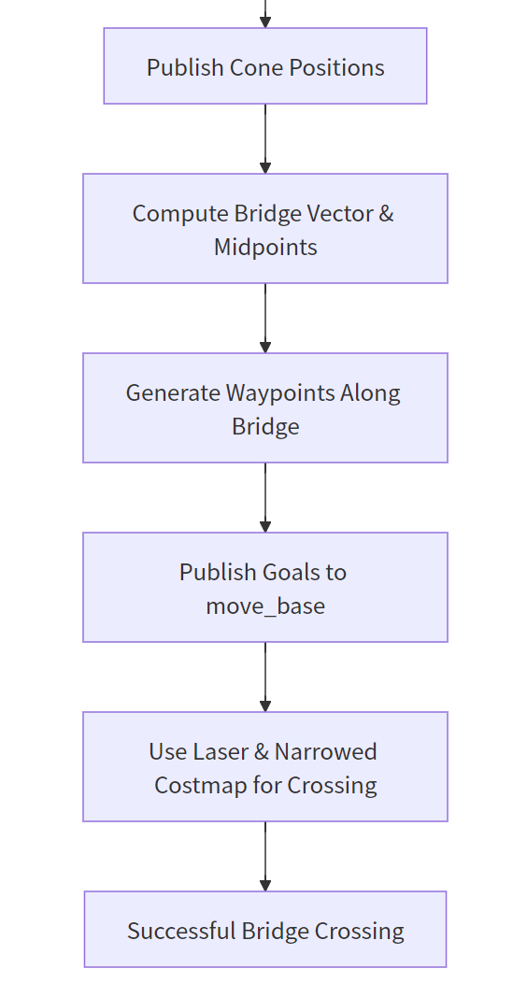
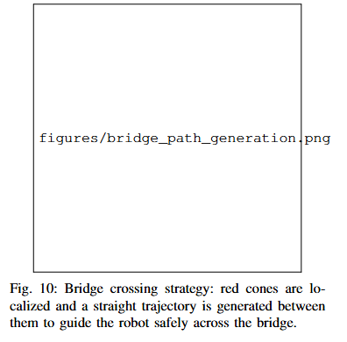
Cross the Bridge

Slide 10
Results and Discussion

Slide 11
Conclusion and Future Work
Project Achievements:
Developed a fully autonomous robotic system using ROS-based modular components.
Successfully integrated:
SLAM-based Mapping (Fast-LIO)
AMCL Localization
Frontier-based Exploration
Path Planning (TEB local planner)
Object Recognition (OCR pipeline)
High-level Behavior Control (Finite State Machine)
Validated in Gazebo simulation:
Accurate 2D map generation
Safe navigation and obstacle avoidance
Region-filtered frontier exploration
Digit-marked box detection & counting
Bridge unlocking and docking maneuvers

Slide 12
Conclusion and Future Work
Strengths:
Modular design for easy debugging and testing
Real-time reactive behaviors
High-resolution mapping (Fast-LIO)
Reliable region-constrained exploration
Limitations:
Drift over long paths (no loop closure)
OCR sensitivity to camera angles/lighting
Greedy exploration lacking global optimization
Improve exploration strategy using reinforcement learning
Future Work:
Integrate loop closure (LIO-SAM) for accuracy
Enhance OCR robustness with YOLO11 + Tesseract

Slide 13
Demo Video Recap

Slide 14
Appendix & Acknowledgement
GitHub - ME5413 FinalProject Group 12: https://github.com/CANLAN-SC/ME5413_Final_Project_Group12.git
T. Shan, B. Englot, et al., “LIO-SAM: Tightly-coupled Lidar Inertial Odometry via Smoothing and Mapping,” in Proc. IEEE/RSJ Int. Conf. on Intelligent Robots and Systems (IROS), 2020.
X. Xu et al., “Fast-LIO: A Fast, Tightly-coupled LiDAR-Inertial Odometry Package,” in IEEE Int. Conf. on Robotics and Automation (ICRA), 2021.
C. Rösmann, F. Hoffmann, and T. Bertram, “Integrated Online Trajectory Planning and Optimization in Distinctive Topologies,” in Proc. of Robotics: Science and Systems (RSS), 2017.
B. Gerkey, R. T. Vaughan, and A. Howard, “The Player/Stage Project: Tools for Multi-Robot and Distributed Sensor Systems,” in Proc. of the Int. Conf. on Advanced Robotics (ICAR), 2003.
M. Quigley et al., “ROS: an open-source Robot Operating System,” in ICRA Workshop on Open Source Software, 2009.
R. Smith, “An Overview of the Tesseract OCR Engine,” in Proc. of the Int. Conf. on Document Analysis and Recognition (ICDAR), 2007.

Slide 15
THANK YOU

